Slide 1
Chromosome Analysis

Slide 2
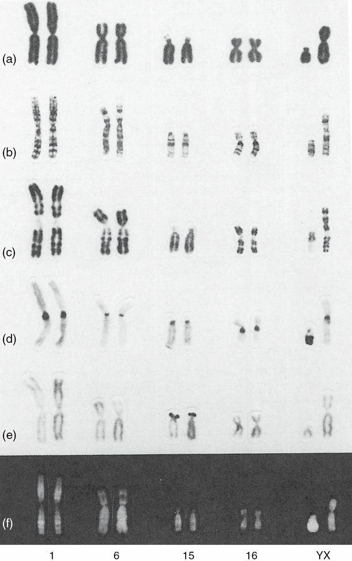
Classic cytogenetic analysis
Plain staining
Giemsa banding
Replication banding
Constitutive banding
Nucleolar organizing regions staining
Fluorescence in situ hybridization
Comparative genomic hybridization
FIGURE 2–1 Chromosome pairs 1, 6, 15, 16, and Y and X stained by various techniques: plain stain (a), G-banding (b), replication banding (c), C-banding (d), Ag-NOR stain (e), and Q-banding (f).

Slide 3
Microarray analysis
Chromosomal microarray is a first-line clinical diagnostic test for individuals with developmental disabilities
Classical cytogenetics is not likely to fade from view. Reasons:
Not all array results can give a definitive construction, and FISH is often necessary to elucidate the cytogenetics
The array cannot detect balanced rearrangements (though whole genome sequencing is being used to address this shortcoming)
Two types of microarrays:
Use a CGH approach
Use SNPs to detect the number of alleles in a specimen

Slide 4
SNP microarray
Heterozygous is distinguished from homozygous and from three alleles
Homozygosity over a stretch of consecutive SNPs may indicate deletion
Three alleles may indicate trisomy
SNP microarray may detect uniparental disomy when the child’s results are compared to the parental genotypes
Isodisomy may be revealed, in the absence of parental samples, when the entire chromosome shows homozygosity

Slide 5
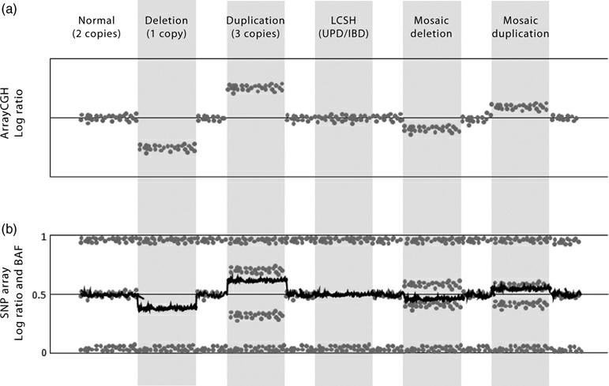
FIGURE 2–2 Interpretation of ArrayCGH compared with SNP array. (a) In ArrayCGH, the signal between the test and reference sample is converted to a log ratio (gray dots) which acts as a proxy for copy number. An increase in log ratio represents a gain in copy number. (b) SNP arrays generate log ratio (black line) by comparing the signal intensities between different SNPs analyzed and offer an additional metric, the B allele frequency (BAF) (gray dots). The BAF is the component of the total allele signal (A + B) explained by a single allele (A): A BAF of 0 represents the genotype A/A or A/–, a BAF of 0.5 represents the genotype A/B, and a BAF of 1 represents the genotype B/B or B/–. Deletions result in the loss of heterozygous (A/B) genotypes, whereas duplications result in a separation of heterozygous genotypes into AA/B and A/BB. The BAF also allows for the detection of copy number neutral abnormalities such as uniparental disomy and identity by descent (IBD) which appear as absence of heterozygous (A/B) genotypes without change to the log ratio

Slide 6
PCR-based applications
QF-PCR and MLPA are targeted approaches to assess DNA copy number
Next generation sequencing
Massively parallel genomic next generation sequencing
Expected a single NGS-based test will generate both copy-number and sequence data, and will become the first-line test for the investigation of children with developmental disabilities

Slide 7
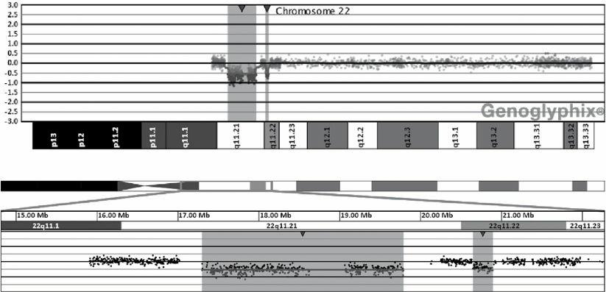
Chromosomal findings from molecular analyses are often presented in an intuitive pictorial form
FIGURE 2–3 Plot of chromosome 22 in a patient with a 22q11 deletion performed using an oligonucleotide-based array with comparative genomic hybridization. The deletion is indicated by the shaded area, which reflects a deviation from the log2 ratio of 1 (equal to zero). Distal to the classic DiGeorge deletion is a common copy number variant (CNV).

Slide 8
Higher resolution strategies may uncover DNA changes of unclear clinical significance, or unwanted information, such as loci that could predispose to cancer or adult-onset disorders

